Slide 1
Data collected for DX699 AI for Leaders course: Includes:
Data from New York Botanical Garden from the NPN website (3 datasets)
Higher education administration dataset
Student tuition dataset
Zip Codes dataset
Healthcare Procedures Dataset
Primary data source: usanpn.org observational phenophase data Presenter: Thomas Zucker-Scharff

Slide 2
USANPN A dataset
Snippet of Data Dictionary
snippet of Data
Field name | Field description
Dataset_ID | The unique identifiers of the dataset(s) (separated by commas) to which the status records that constitute the series belong. More information can be found in the ancillary data file for "Dataset". A value of "-9999" indicates one or more status records were submitted via the online Nature's Notebook application.
ObservedBy_Person_ID | The unique identifiers of the person(s) (separated by commas) who made the status observations that constitute the series. More information can be found in the ancillary data file for "Person". A value of "-1" indicates the identity of the observer is unknown.
Partner_Group | The name of the partner group with which the series is associated. A value of "-9999" indicates the organism being monitored is not associated with a partner group.
Site_ID | The unique identifier of the site at which the series was recorded. More information can be found in the ancillary data file for "Site".
Site_Name | The user-defined name of the site at which the series was recorded.
Latitude | The latitude of the site at which the series was recorded. Generally lat/long is calculated from the Google Maps API with a datum of WGS84 (https://developers.google.com/maps), unless a plausible user-defined lat/long was submitted. Information about the datum and source of the lat/long value can be found in the "Site" ancillary data file.
SiteID | Lat | Longi | Elev(m) | State | SpeciesID | Genus | Species | Common_Name
1668 | 40.866283 | -73.875717 | 21 | NY | 79 | Fagus | grandifolia | American beech
1668 | 40.866283 | -73.875717 | 21 | NY | 79 | Fagus | grandifolia | American beech
1668 | 40.866283 | -73.875717 | 21 | NY | 79 | Fagus | grandifolia | American beech
1668 | 40.866283 | -73.875717 | 21 | NY | 79 | Fagus | grandifolia | American beech
1668 | 40.866283 | -73.875717 | 21 | NY | 79 | Fagus | grandifolia | American beech
Perceived value of dataset
The NPN A dataset may be useful in forecasting the ability of different species’ survival rates in various microclimates within the New York Botanical Garden.
The ability to forecast the relevant information could be used to decide which species would be most likely to survive in a given area within the Garden.
This should also provide data that could inform a decision maker on which species would be best suited for preservation activities
The longitudinal data collected should show how the change in weather over time has affected the phenophase presentation of each specimen.
Features of interest in this dataset:
Positional/Geographic data
Elevation
Date of Observation
Phenophase
Kingdom, Genus, Species
Temperature Conditions
Precipitation
Some questions that could be answered using this dataset are:
Has there been a change of when a specific phenophase is manifests by date?
Which specimens do best in this environment?
How is the climate affecting the manifestation of each phenophase?
What types of weather have shown to have the most benefit for each of the different species represented?
Which type of specimen is hit the hardest (by genus/species)?
Do these specimens grow better in urban environments(see BU website)?

Slide 3
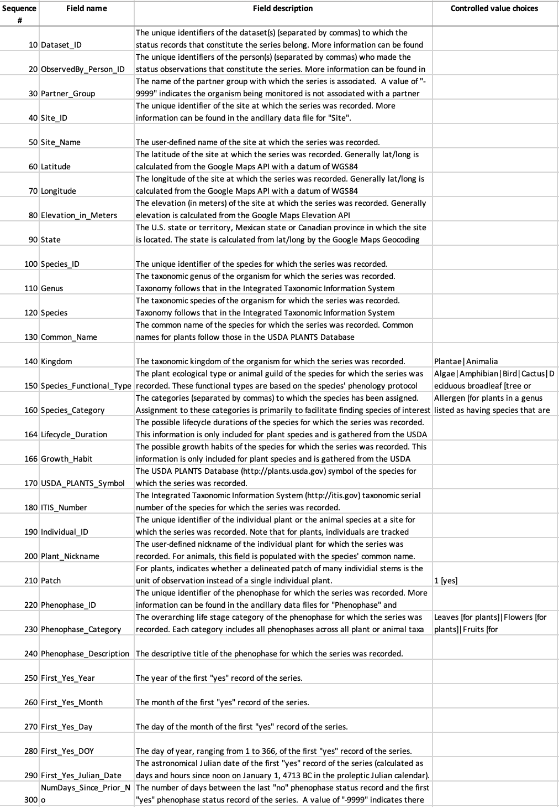
The NPN B dataset
Dataset Snippet Data Dictionary Snippet
Perceived value of dataset
Site_ID | Latitude | Longitude | Elev (m) | State | SpeciesID | Genus
507 | 42.335072 | -79.608025 | 185 | NY | 161 | Erythronium
507 | 42.335072 | -79.608025 | 185 | NY | 161 | Erythronium
1060 | 42.967205 | -76.366562 | 302 | NY | 29 | Prunus
1060 | 42.967205 | -76.366562 | 302 | NY | 29 | Prunus
1060 | 42.967205 | -76.366562 | 302 | NY | 36 | Syringa
1444 | 42.722549 | -78.84343 | 239 | NY | 36 | Syringa
1444 | 42.722549 | -78.84343 | 239 | NY | 36 | Syringa
The NPN B dataset may be useful in forecasting the ability of different species’ survival rates in microclimates other than the New York Botanical Garden, since the data encompasses sites through out the state of New York
Since the dataset covers areas within the state of New York, it could inform a decision maker on the best places in the state to situate each specimen.
A comparison of survival rates in different areas could provide important feedback regarding the ability of a species to survive in a given microclimate.
Snippet
Value
Dictionary
Features
Geospacial
Species
Precipitation
Elevation
Questions that may be answered using this dataset:
What affects the species survival rate in terms of the amount of precipitation?
Is a certain species more likely to survive in one microclimate over another?

Slide 4
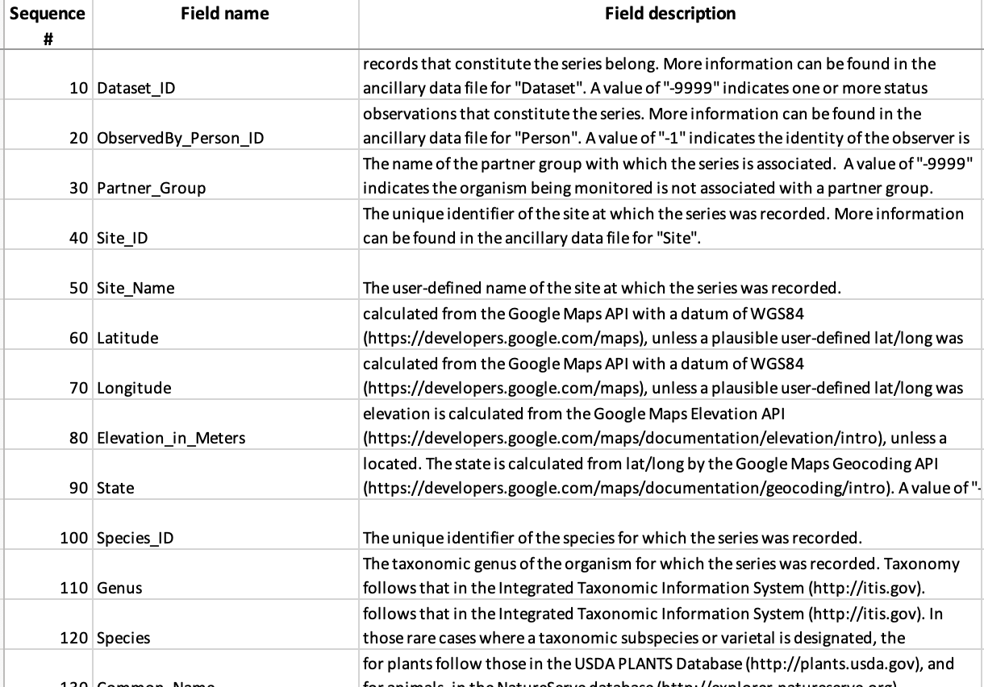
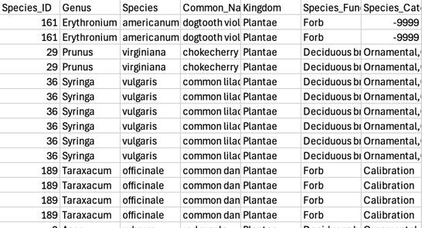
The NPN C dataset
Data Dictionary Snippet Dataset Snippet
Perceived value of dataset
This dataset contains similar data to the NPN A dataset but covers a wider area (all of NY State rather than just NYBG). This is important as this can help us answer other questions that pertain to comparisons between areas.
The strength of the dataset is the breadth of the area it covers.
I believe this data may be used to find the best microclimates for a particular species to survive.
Snippet of Dataset
Data Dictionary
Perceived Value
Features of Interest
Sites
Observers
Training (inferred from other data)
Geospacial information
Latitutde
Longitude
Altitude
Etc.
Weather conditions
Site ID
Questions that could be answered with this dataset are:
What is the best microclimate for a particular species?
How is a species’ health affected by the type of microclimate (urban vs. suburban for instance)?
Is there a correlation between how many and how specific an observation is and the area in which it is observed?
How many of these observations are done by someone who has been trained to look for certain data?

Slide 5
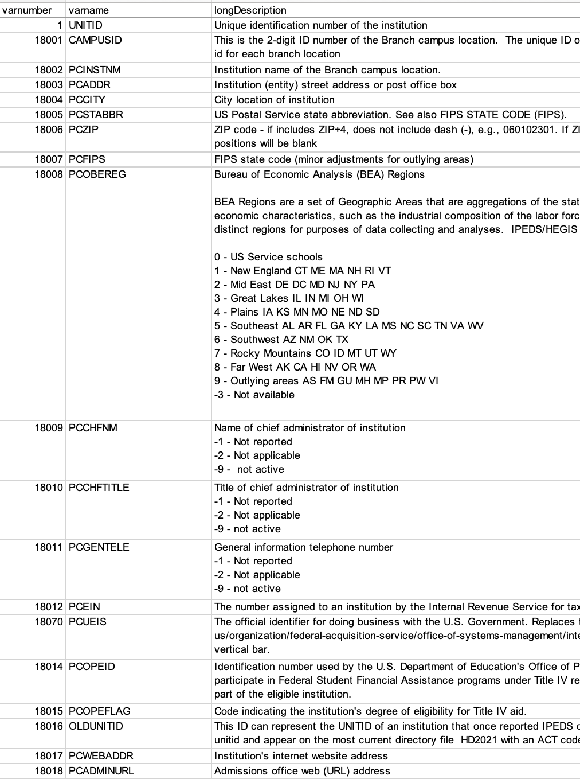
Higher education administration dataset
Dataset Snippet Data Dictionary Snippet
Perceived value of dataset
ADDR | CITY | STABBR | ZIP | FIPS | OBEREG | CHFNM
4900 Meridian Street | Normal | AL | 35762 | 1 | 5 | Dr. Daniel K. Wims
Administration Bldg Suite 1070 | Birmingham | AL | 35294-0110 | 1 | 5 | Ray L. Watts
1200 Taylor Rd | Montgomery | AL | 36117-3553 | 1 | 5 | Michael C.Turner
301 Sparkman Dr | Huntsville | AL | 35899 | 1 | 5 | Chuck Karr
915 S Jackson Street | Montgomery | AL | 36104-0271 | 1 | 5 | Quinton T. Ross
500 University Blvd. East | Tuscaloosa | AL | 35401 | 1 | 5 | Finis St. John IV
739 University Blvd | Tuscaloosa | AL | 35487-0100 | 1 | 5 | Dr. Stuart R. Bell
1675 Cherokee Rd | Alexander City | AL | 35010 | 1 | 5 | Jeff Lynn
300 N Beaty St | Athens | AL | 35611 | 1 | 5 | Dr. Catherine Wehlburg
7440 East Drive | Montgomery | AL | 36117-3596 | 1 | 5 | Carl A. Stockton
 | Auburn | AL | 36849 | 1 | 5 | Chris Roberts
900 Arkadelphia Road | Birmingham | AL | 35254 | 1 | 5 | Mr. Daniel Coleman
2602 College Drive | Phenix City | AL | 36869 | 1 | 5 | Jacqueline Screws
This may be highly useful in predicting/finding the institutions in any one area given certain preferences (i.e., 2 year versus 4 year institution, geographic area).
Snippet
Value
Features
Dictionary
Questions that may be answered using this dataset:
What the population is in a given geographic area, using the number of institutions as an indicator?
Is an institution more likely to be a 2 vs a 4 year one given the geographic area?

Slide 6
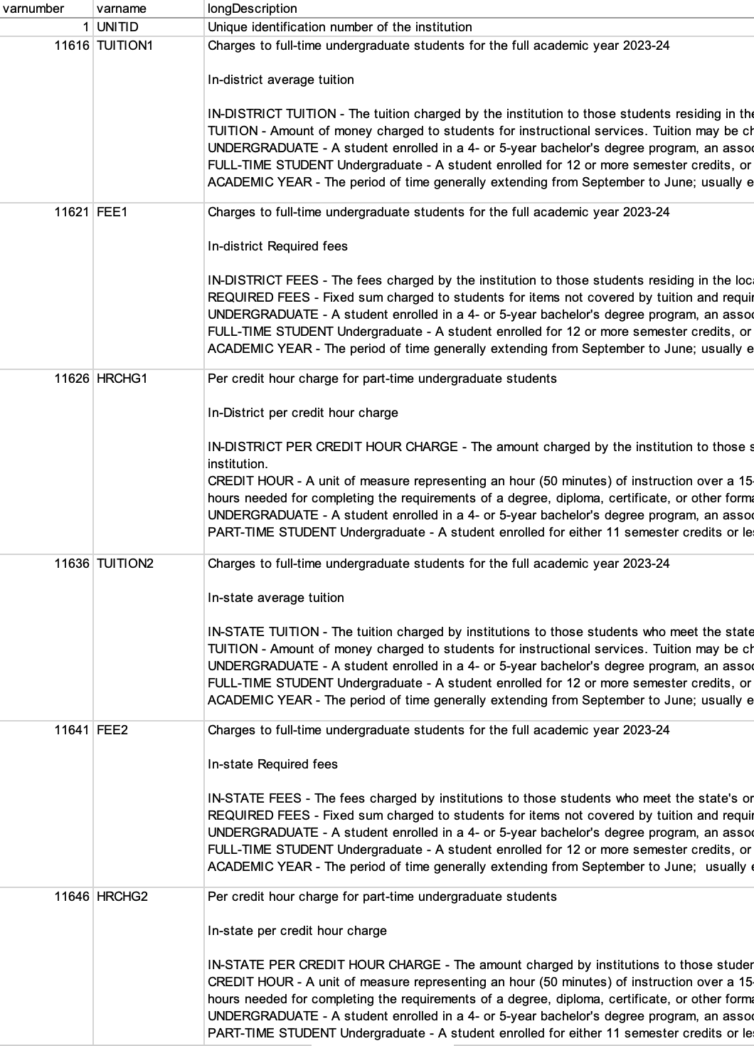
The Student tuition dataset
Dataset Snippet Data Dictionary Snippet
Perceived value of dataset
UNITID | XTUIT1 | TUITION1 | XFEE1 | FEE1 | XHRCHG1
100654 | R | 8610 | R | 1414 | R
100663 | R | 8832 | R | 0 | R
100690 | R | 9480 | R | 990 | R
100706 | R | 10120 | R | 1758 | R
100724 | R | 8328 | R | 2920 | R
100751 | R | 11100 | R | 800 | R
100760 | R | 3810 | R | 1230 | R
This dataset can inform us about the cost of various institutions (historically)
This dataset might also be used to ascertain which the best institution is to attend given a stated major.
Snippet
Value
Features
Dictionary
Questions that may be answered using this dataset:
What the average cost of a 4-year education is
What the average cost of a 2-year education runs.
Is it better to start at a 2-year institution and transfer to a 4-year one, in terms of the cost of a 4-year education?

Slide 7
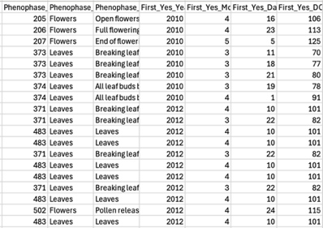
The Zip Codes dataset
Dataset Snippet
Perceived value of dataset
This dataset is most useful when combined with other datasets.
Using this data could better prepare emergency units, assuming that anyone over a certain age might need help to evacuate.
This dataset also has dependent information in it which might be useful.
Snippet
Value
Questions
Features
Zip code
Area description
Age grouping data
Questions that could be answered using this dataset:
What is the average age in a given zipcode?
Where do the most people over 65 live?
Where do the most people under 30 live?

Slide 8
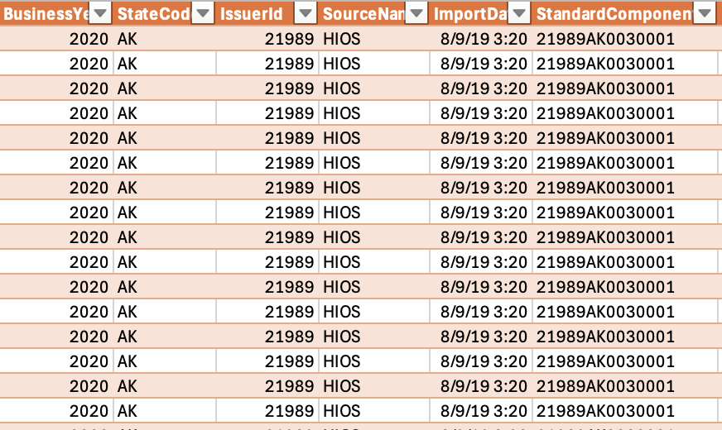
The Health care procedures dataset
Dataset Snippet
Perceived value of dataset
This dataset is valuable in the type of information contained in it.
One can ascertain from the data various attributes that may make a procedure more likely to be covered by insurance and in so doing define the best procedures to get at any given time.
This would also be valuable to an institution because it speaks to which insurance would pay the most for which procedures.
Snippet
Value
Questions
Features
Procedure Type
Facility Type
Facility location
Type of plan
State
Year
Questions that could be answered using this dataset:
How likely is a procedure going to be covered, if performed in a certain type of facility?
Which types of plan are most likely to cover which procedures?
Do some states/locales have better coverage than others?
Does the date have any impact on the coverage amount?

Slide 9
Decision tree for USA NPN A dataset
With the assumption that the coordinate pairs of Latitude and Longitude match, the following needs to be investigated:
 |  |  |  |  |  |  |  | Same Species (species ID same)
 |  |  |  |  |  |  | Same individual (individual ID same) |  |  |  |  |  |  |  |  |  | Different individual - start again
 |  | Phenophase category indicates flowering or cones |  |  |  |  |  |  | Does phenophase category indicate flowers or cones
 | historical temperature up |  |  |  | historical temperature down |  |  |  |  | Is there a next observation |  |  |  |  |  |  | Individual has died
 |  |  |  |  |  |  |  |  | individual is still alive |  |  | individual has died | individual has died
 | precip up |  | precip down | precip up |  | precip up |  | precip down
will survive in this microclimate |  |  | will not survive | will not survive |  | will not survive |  | will survive in this microclimate |  |  | ← Target
Based on the following feature set:
SpeciesID (level 1)
Individual_ID (level 2)
Phenophase Category (level 3)
Temperature (level 4)
Precipitation (level 5)
CONCLUSION

Slide 10
USA NPN A dataset decision tree pseudo code
If species id matches
if Indivdual ID matches
If phenophase category indicates flowering or cones
if historical temperature is up
If precipitation is up
set target to survived
else (precipitation is down)
set target to died
if historical temperature is down
if precipitation is down
set target to died
else
set target to survived
else (phenophase doesn’t indicate flowering or cones)
if there is a next observation
set target to survived
elif no next observation
set target to died
else
set target to died
else (individual does not match)
loop again

